Slide 1
Keep Playing
DRP Group 43: VLAD, ADI, OSCAR, NICOLAS

Slide 2
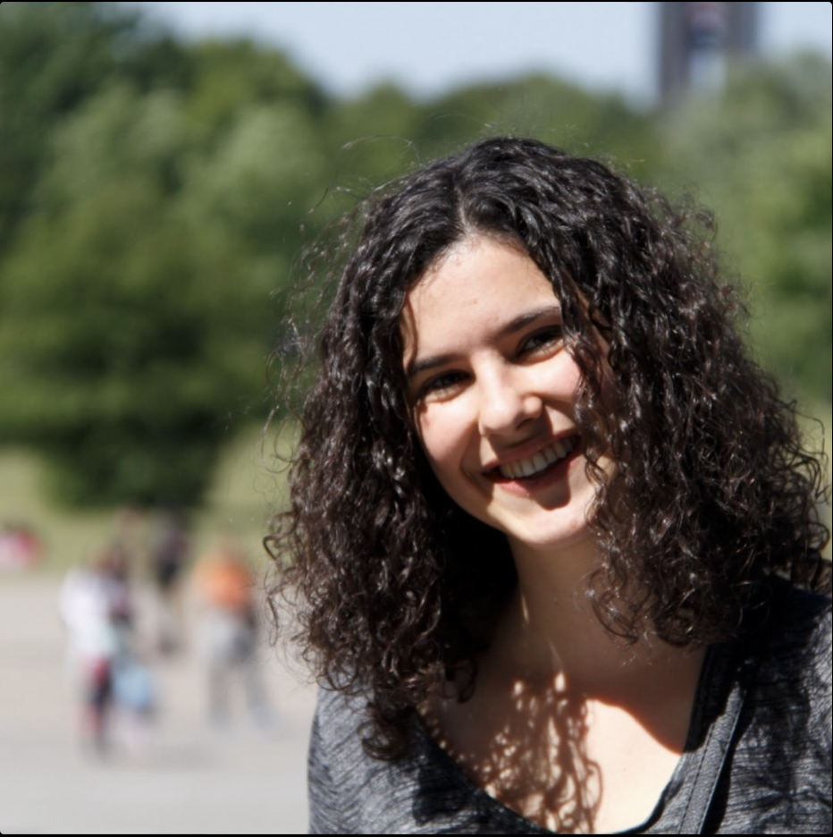
Meet Marta
Passionate about her degree
Spends time with her friends
Eager to improve at Muay Thai
Helps others get into sport

Slide 3
Meet Marta
Lots of responsibilities
Spends time with her friends
Eager to improve at Muay Thai
Helps others get into sport

Slide 4
Meet Marta
Lots of responsibilities
Must choose between work and friends
Eager to improve at Muay Thai
Helps others get into sport

Slide 5
Meet Marta
Lots of responsibilities
Must choose between work and friends
Hard to progress in Muay Thai
Helps others get into sport

Slide 6
Meet Marta
Lots of responsibilities
Must choose between work and friends
Hard to progress in Muay Thai
People are reluctant to join the society

Slide 7
86%
4
4.6
of sport society captains report stress and anxiety when organizing events¹
1. 'Organisation of Sports Events in Student Societies', Student form, Imperial College London

Slide 8
4
86%
4.6
median cancellations per term¹
1. 'Organisation of Sports Events in Student Societies', Student form, Imperial College London

Slide 9
4.6
4
86%
Difficulty on scale of 1-5 for finding coaches/refs¹.
1. 'Organisation of Sports Events in Student Societies', Student form, Imperial College London

Slide 10
"To find coaches, we go through mailing lists to try and find some near Imperial, but the lists are never up to date"
- Angelo, Water Polo treasurer ​

Slide 11
"I don't even bother trying to find a replacement [referee]....I just cancel the games"
- Keion, Futsal President & Captain

Slide 12
How might we replace existing ways of contacting sport professionals by societies at universities through offering access to a wide network in order to relieve the stress committee members must handle?

Slide 13
Our solution is a scheduling application that connects sport societies at Universities to sports professionals, letting organisers pick the best fit for them.

Slide 14
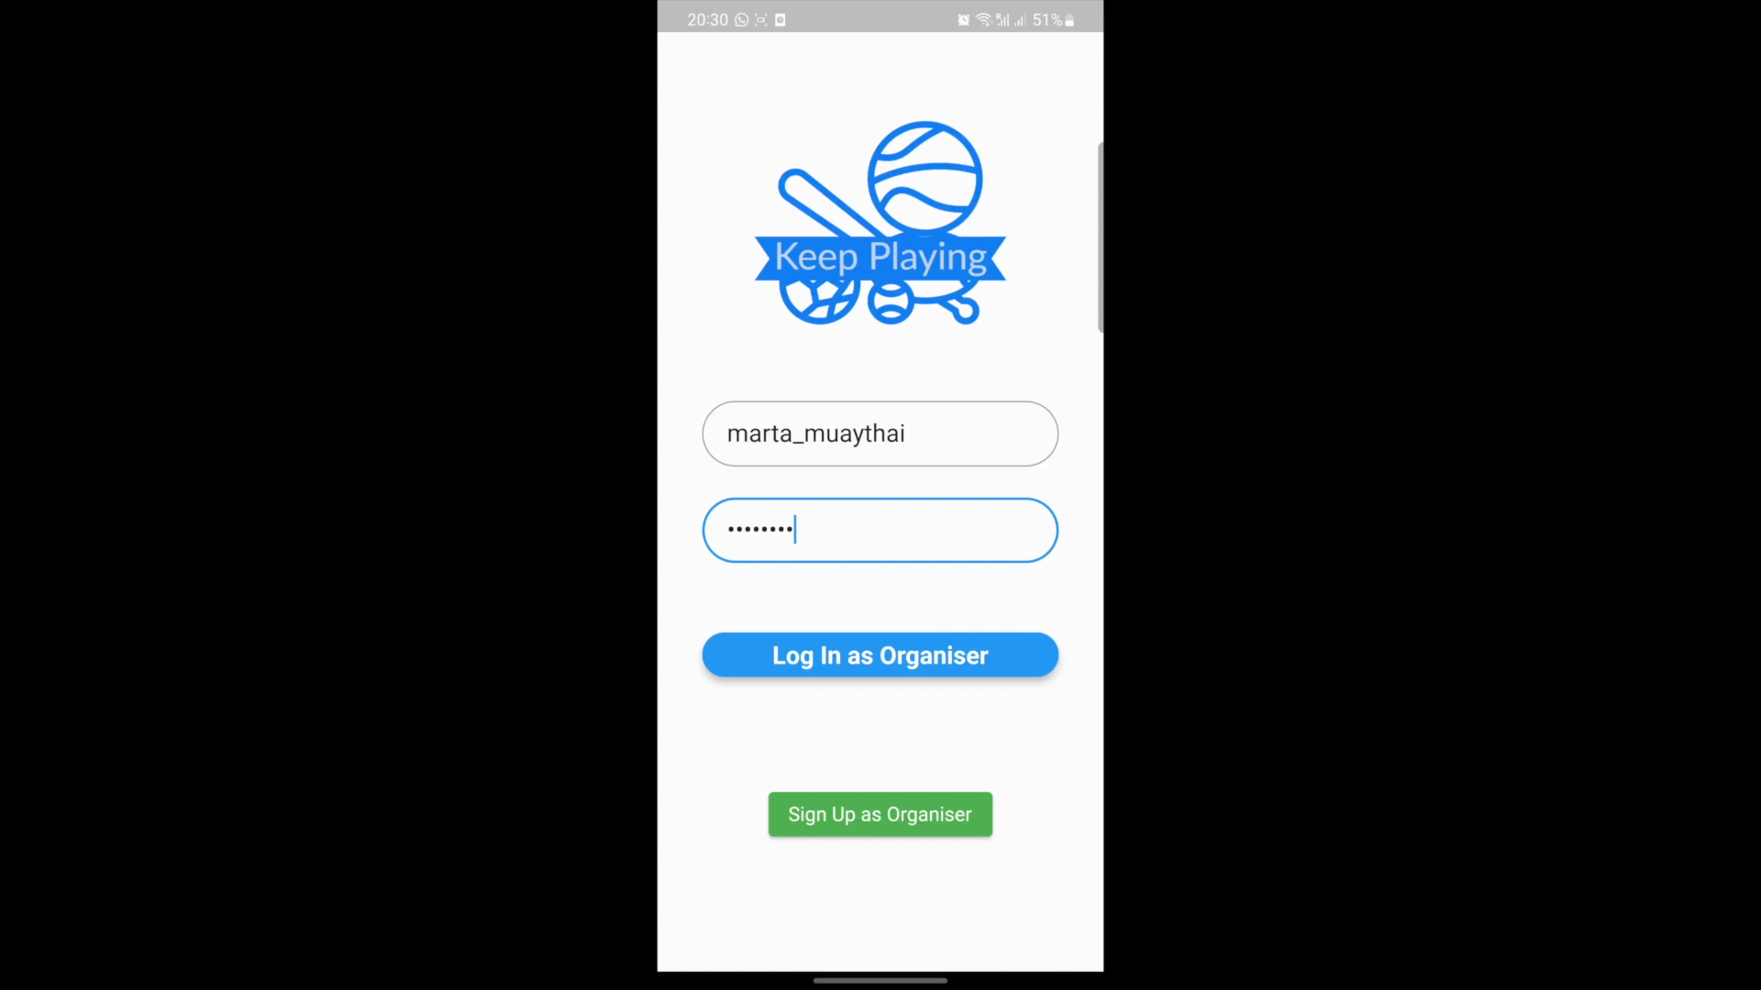

Slide 15
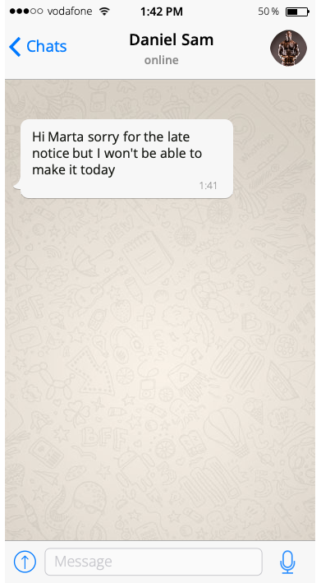
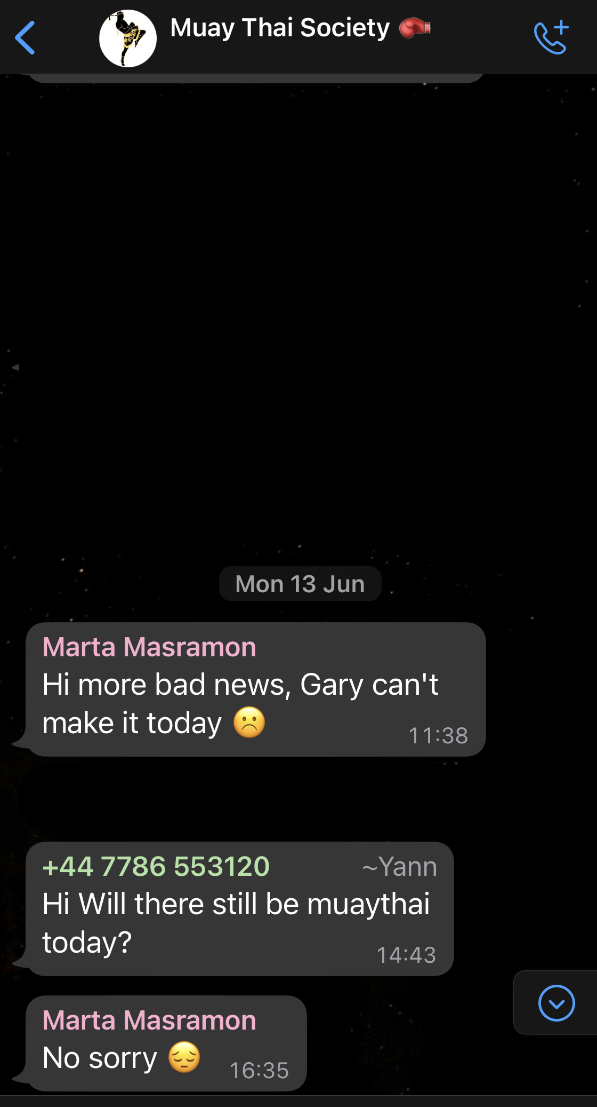
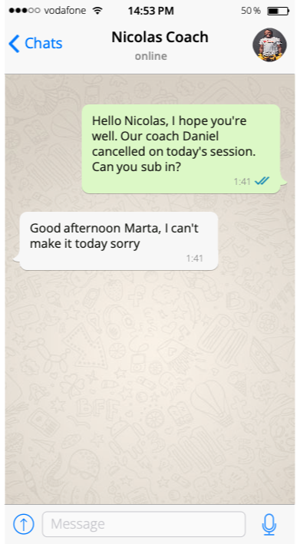
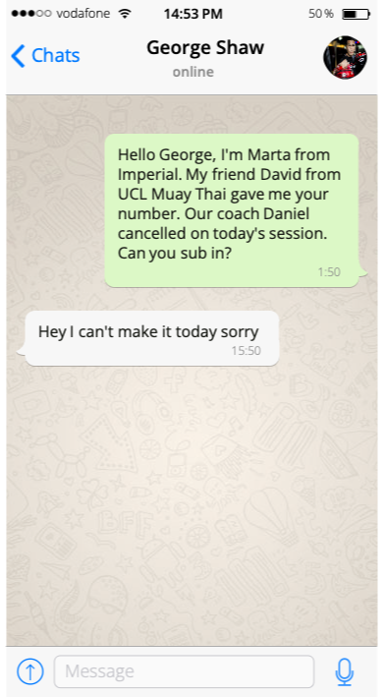
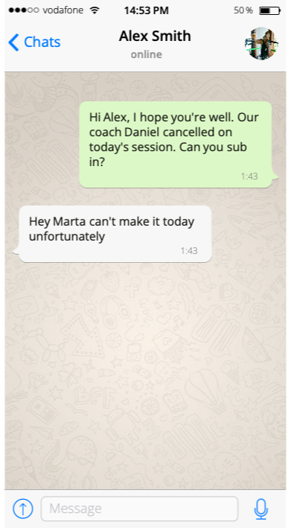
Old Journey

Slide 16
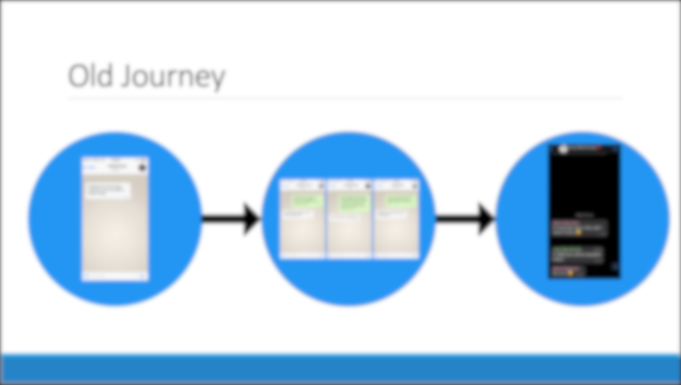
1

Slide 17
2

Slide 18
3
3

Slide 19
New Journey
Marta posts a new job and coaches start applying

Slide 20
New Journey
She receives email updates about new offers and can pick the best fit

Slide 21
New Journey
She can manage her existing events, see coach information and contact details

Slide 22
New Journey
After the event, she can rate her experience, so she and other organisers can benefit

Slide 23
Human-Centered Design

Slide 24
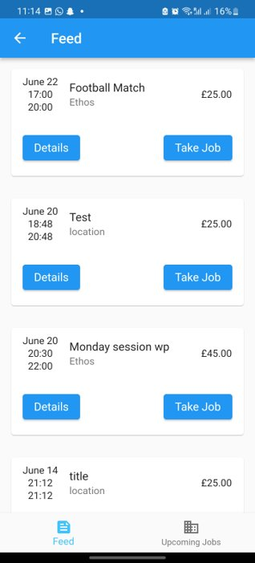
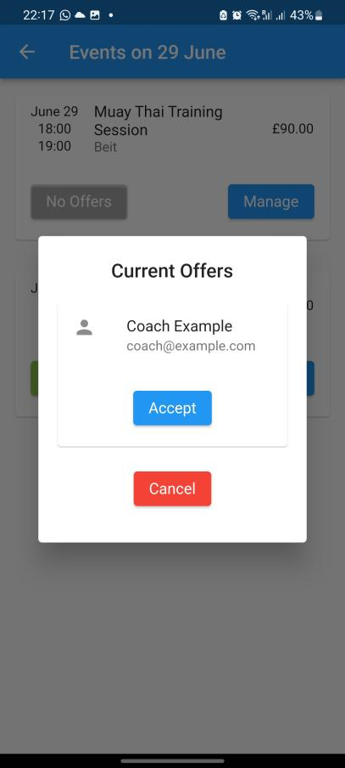
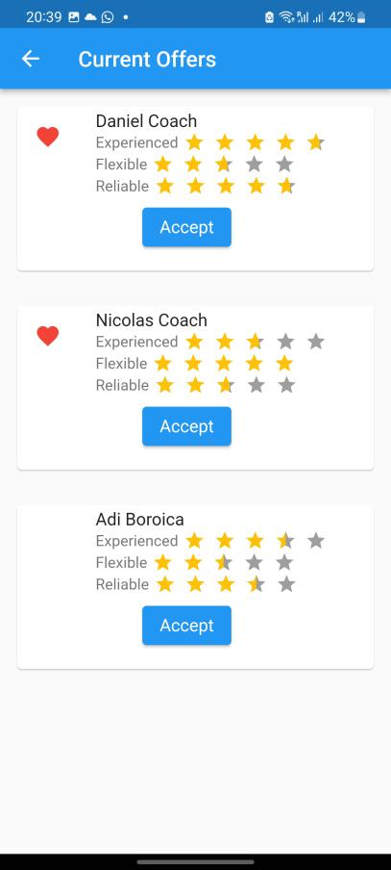
Pick the coach you want, not any coach
"I have no information about any of these coaches though, how do I know which to choose?" - Javier, UCL Hockey Society

Slide 25
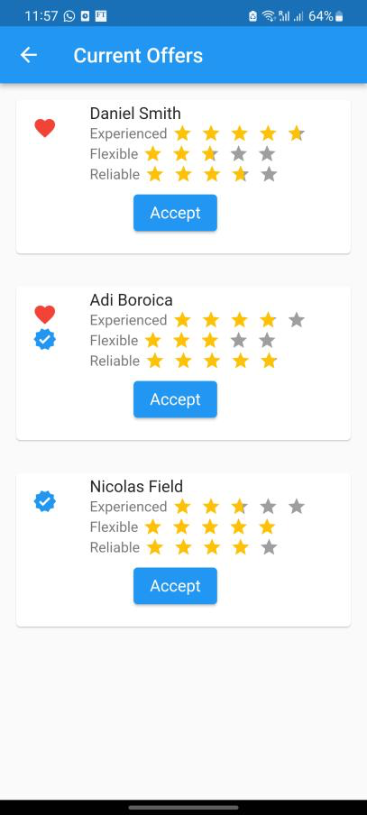
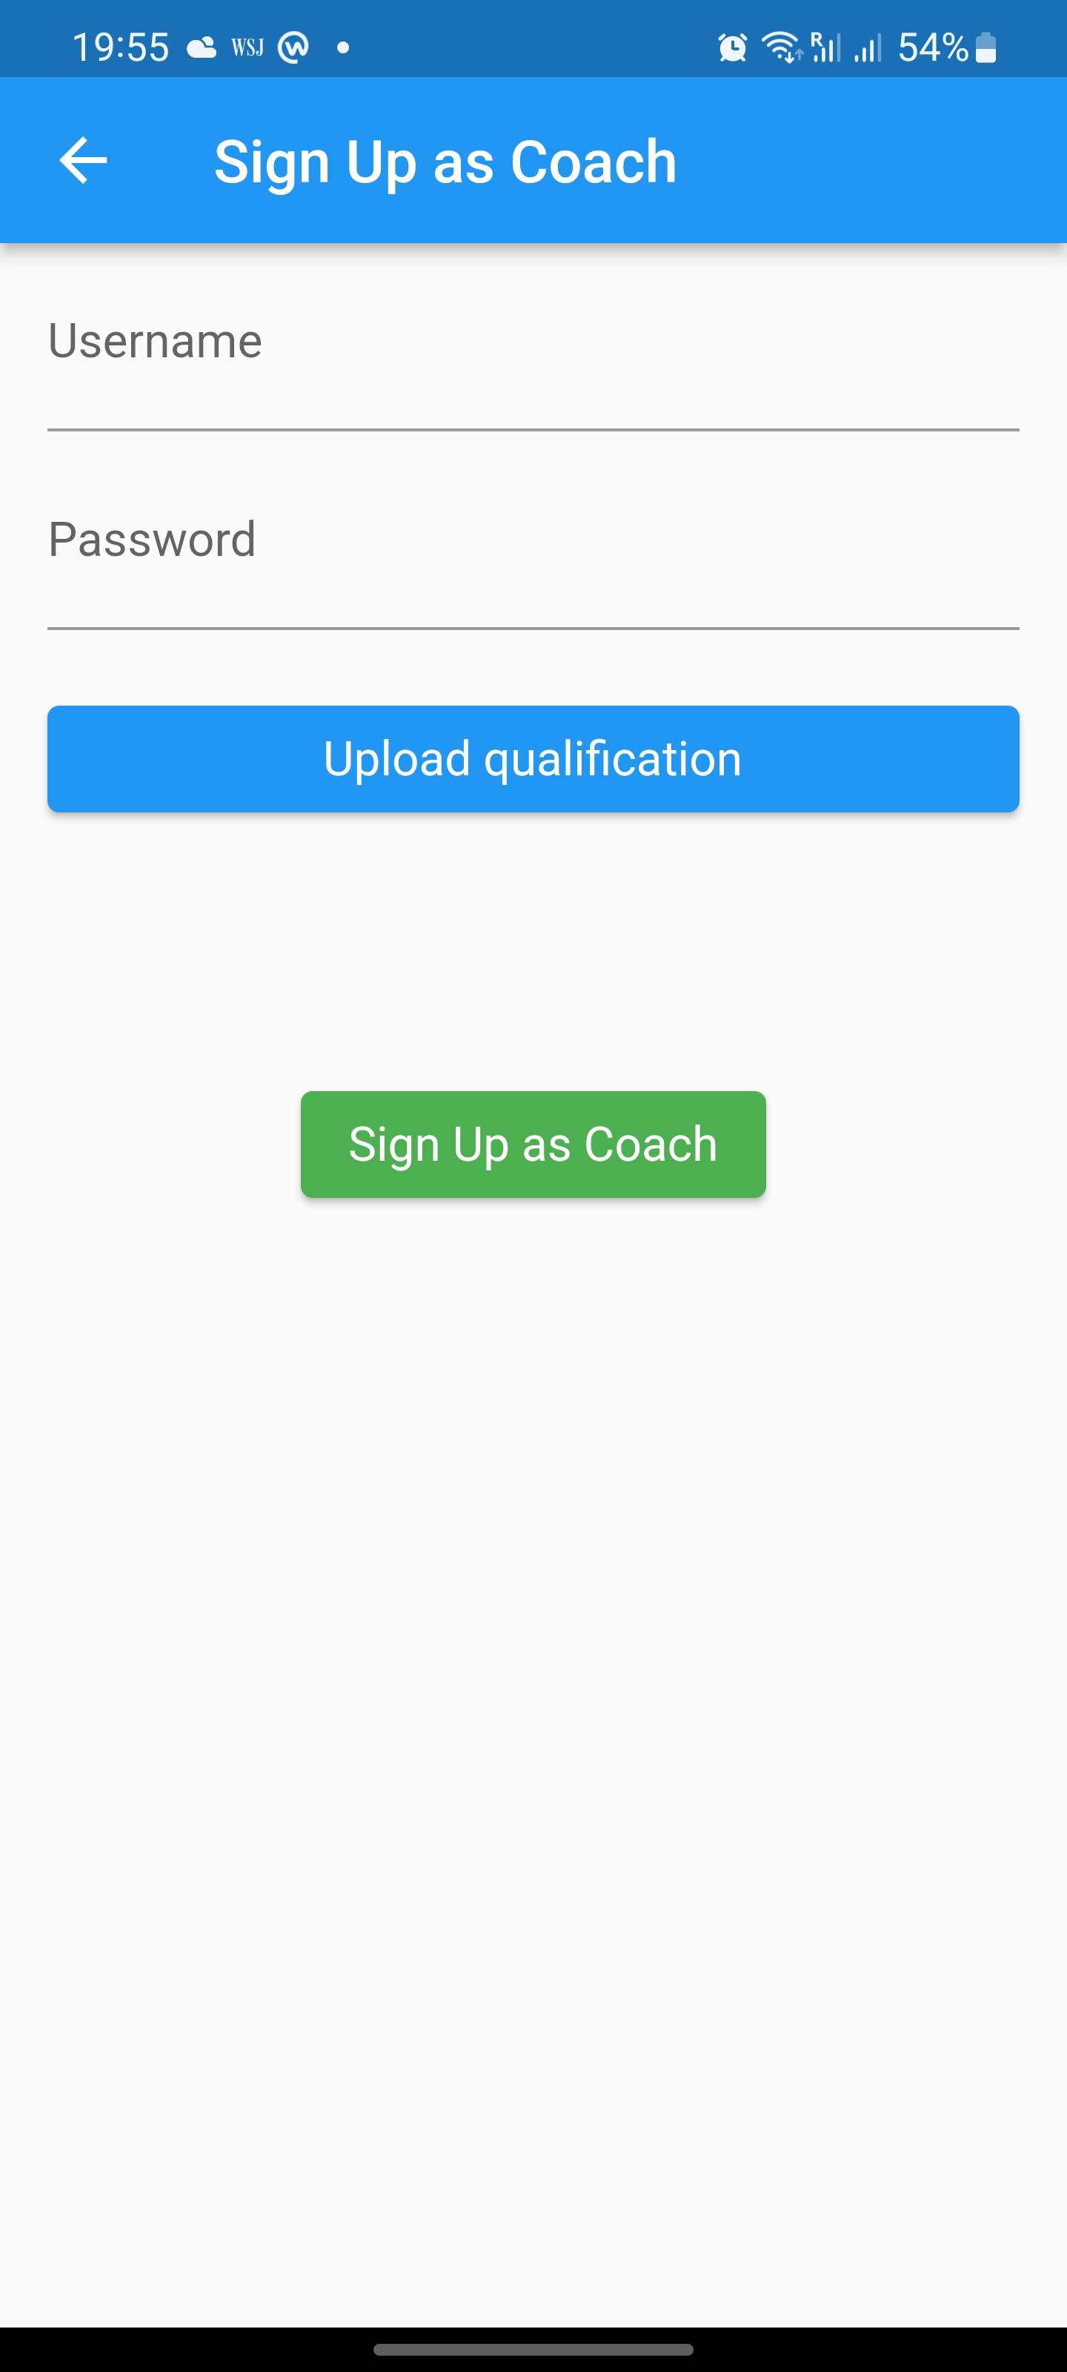
Qualification Verification
"For fencing we require coaches and referees to be certified. Where is this in the app?" - Wan Hee, Fencing coach & referee

Slide 26
Technical Design

Slide 27


Choice of Framework & Languages
Mobile Application
Flutter
Highly customizable – Material Design out of the box
Reliability & Flexibility – Cross platform & support for older devices
Django
Support for fast development and quick iterations

Slide 28
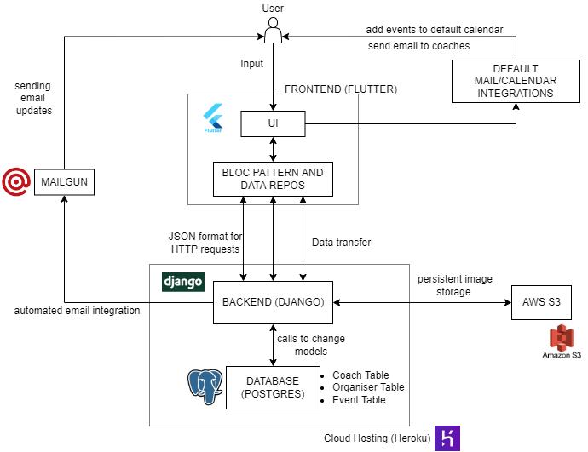
System Diagram

Slide 29
Conclusion & Evaluation

Slide 30
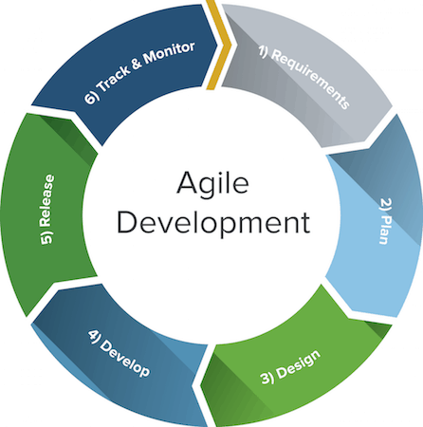


What went well?
Lots of perspectives on the problem & the solution we designed

Slide 31
What went well?
Agile development & task management for quick user feedback and validation of idea

Slide 32
What went well?
Quick adjustment to new frameworks & development tools

Slide 33





What would we do differently?
Ask better questions, focus on meaningful interactions

Slide 34
What would we do differently?
Avoid jumping to conclusions, wait for ideas to be validated

Slide 35
What would we do differently?
Get more diverse stakeholders, by including more universities

Slide 36
User Benefit & Value: Marta's New Normal
More time enjoying Muay Thai as a hobby, rather than a chore
Fulfillment and pride from being society leader as she feels more in control and receives more involvement from club members

Slide 37
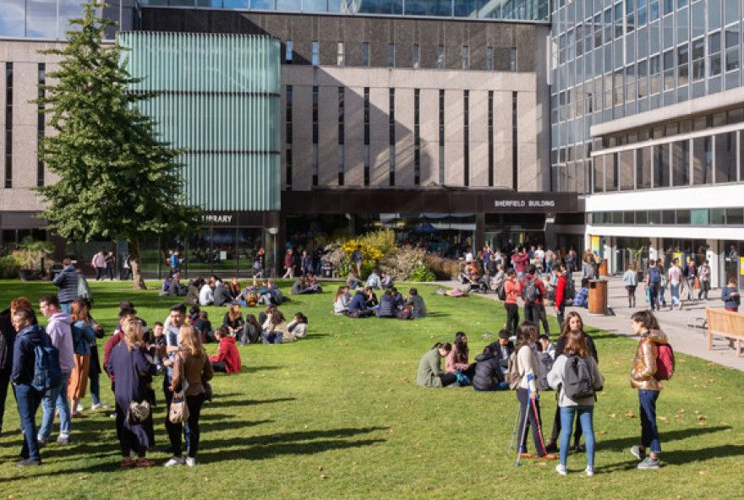
User Benefit & Value: Bigger Picture
Sports societies are better organised, and more appealing for everyone to join
Students have more engagement with student body and lead more active lifestyles

Slide 38

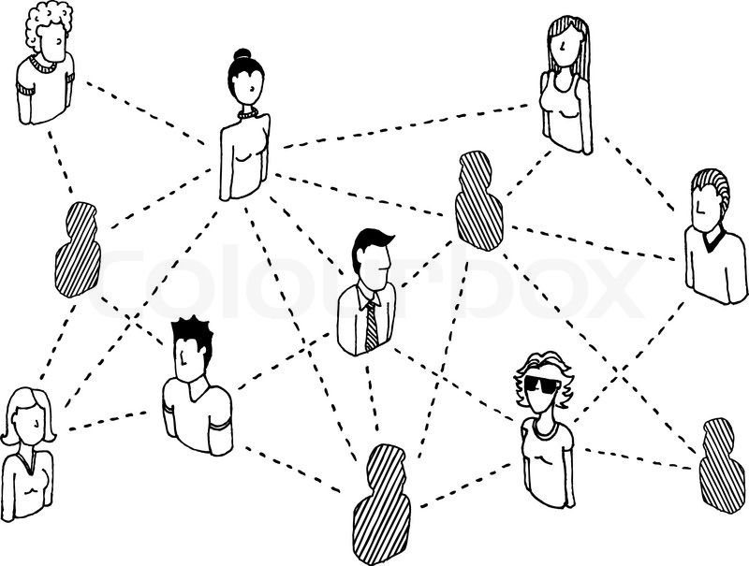
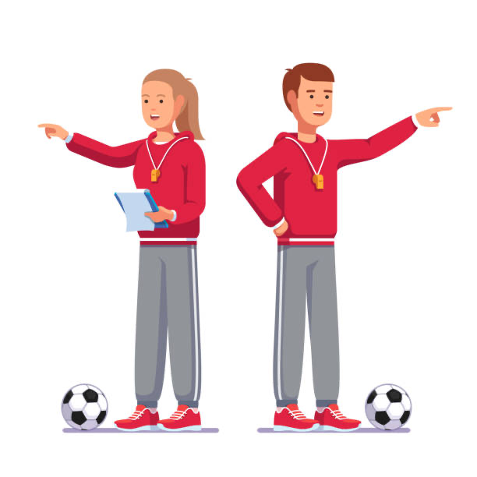
Future Work
Repeat the process from coach's point of view, designing the best experience for them as well

Slide 39
Future Work
Design a more well-rounded review system, include more diverse sources of information

Slide 40
Future Work
Get samples from more meaningful metrics, such as the number of jobs filled, and time needed to get an offer

Slide 41
Thank you for your attention!

